Slide 1
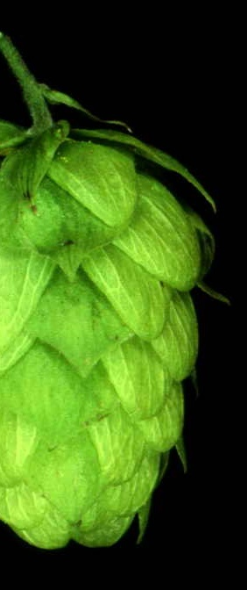
The Bitter, Twisted
Truth of the Hop
50 Years of Hop Chemistry
Joint Technical Meeting:
MBAA Rocky Mountain District &
ASBC Wild West Chapter
November 6th, 2008
David Ryder, Patrick Ting & Sue Kay
MillerCoors
Milwaukee, USA

Slide 2

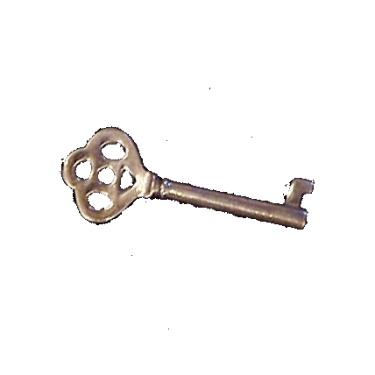
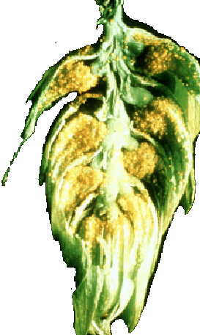

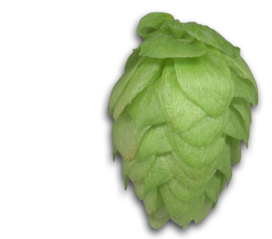
Unlocking 50 years
of hop chemistry
O
O
O
O
CH₃
O
O
O
O
O
O
CH₃
HO
hv
R
R
SH
R
HO
R
H
HO
R
O
SH⁻
O
CH₃
OH
OH
OH
OH
OH
O
O
O
OH

Slide 3
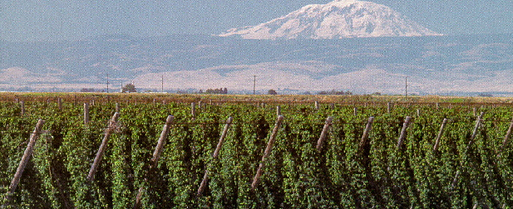
Unfolding HOP Chemistry
(1958-2008)
Characterization of Bittering Acids
Improved Utilization
Light Stability
Organic Solvent Free Hop Products
Foam and Anti-Microbial
Flavor and Flavor Stability
1958
1963
1968
1973
1978
1983
1988
1993
1998
2003
2008

Slide 4
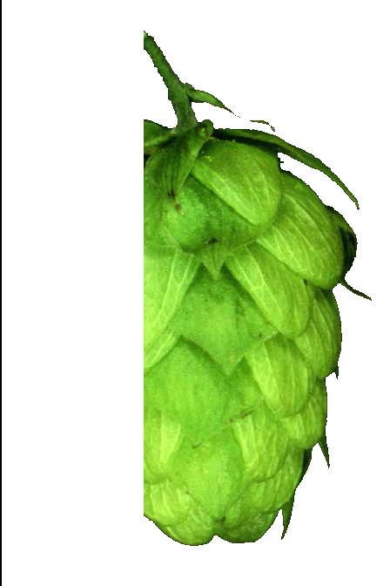
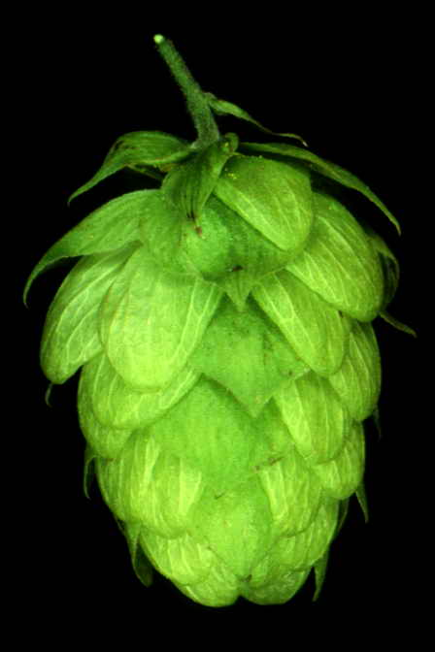
1950’s-1980’s
Characterization
of Bittering Acids

Slide 5
O
O
R
Characterization
of Humulone
(Cook, Harrison, Carson,
Verzele)
O
OH
OH
R= CH₂CH(CH₃)₂
α−Fraction
separated into co, n and adhumulone (Rigby, Bethune, Meilgaard)
  R =CH(CH₃)₂ co-
  CH₂CH(CH₃)₂ n-
  CHCH₃CH₂CH₃ ad-

Slide 6
O
O
O
O
R
R
HO
O
OH
O
OH
OH
• Determined α-acids are converted to iso-α- acids in the brewing process.
• Quantified contribution of iso-α-acids to beer bitterness.
(Rigby, Bethune, Meilgaard)

Slide 7
Established R-configuration of α-acids and
stereoisomers of iso-α-acids. (De Keukeleire, Verzele)
O
O
O
O
O
O
O
R
R
+
HO
H
H
R
O
OH
OH
OH
OH
OH
O
α-Acids
trans-Iso-α-Acids
cis-Iso-α-Acids

Slide 8
β-Fraction
separated into
co, n and adlupulone
(Riedl, Verzele, Govaert,
Howard, Rigby, Bethune)
O
O
R
O
OH
R = CH(CH₃)₂ co-
CH₂CH(CH₃)₂ n-
CHCH₃CH₂CH₃ ad-

Slide 9
1950’s-1990’s
Improved
Utilization

Slide 10
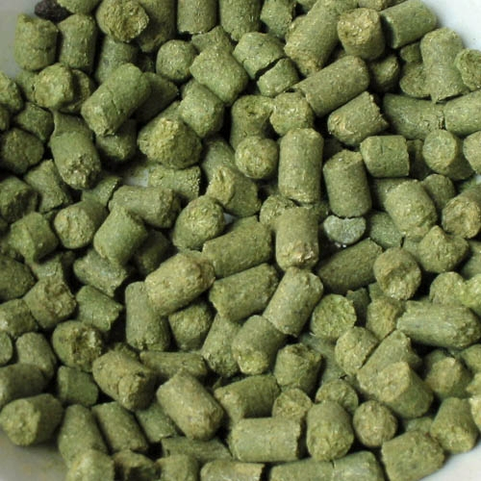
Commercial Production
Organic Solvents
    • Hop extracts - Concentrated α-acids
    • Pre-isomerized extracts - Kettle extract
    • Post kettle extract by Carlton & United Breweries
    Non-Solvent
    • Isomerized hop pellets by Grant of S.S. Steiner

Slide 11

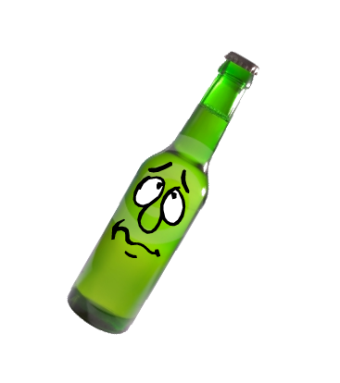
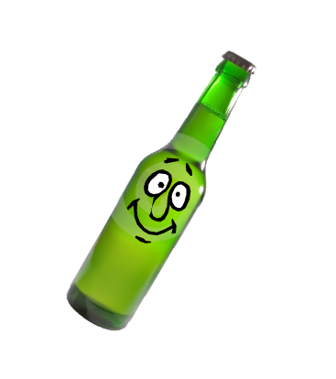


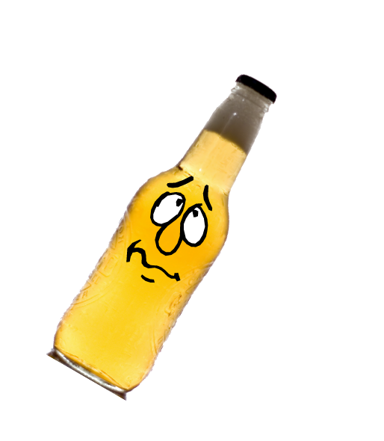
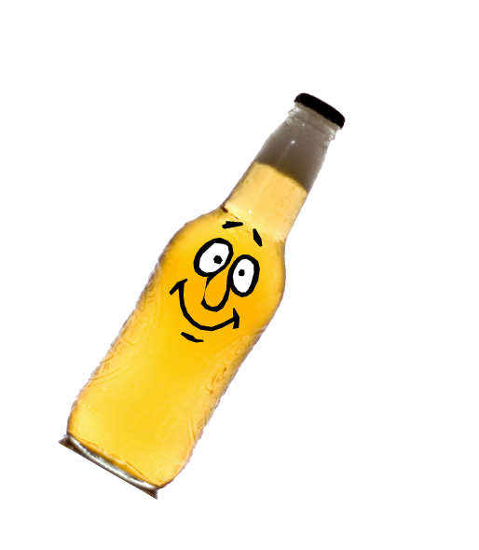


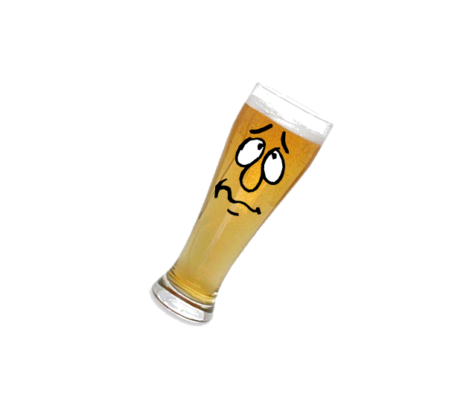




Slide 12
1950’s-2008
Light
Stability

Slide 13

In the 50’s, Miller Brewing discovered under UV or visible light (in the presence of riboflavin) iso-α-acids and sulfur caused light instability in beer.

Slide 14

The sun-struck or skunky flavor (3M2B1T) and the mechanism of its evolution was later characterized by Kuroiwa, et al. of Kirin Breweries in the early 60’s.
O
O
R
hv
SH
HO
OH
SH⁻
O
3-Methyl-2-Butene-1-Thiol
(3M2B1T or MBT)

Slide 15
  Miller Brewing patented a commercially viable process to produce light stable ρ-iso-α-acids.
O
O
O
O
O
O
R
OH⁻
R
NaBH₄
R
HO
HO
O
OH
O
OH
OH
OH
OH
α-Acids
Iso-α-acids
ρ-Iso-α-acids
  In 1961, light stable beer made its debut in flint bottles.

Slide 16
1970’s-2008
Organic
Solvent Free Hop Extract

Slide 17
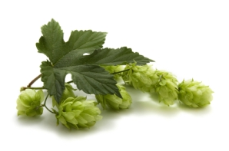
In 1975, Laws et al. of BRF introduced liquid CO₂ hop extracts (rich in α-acids, β-acids, and essential oils) under 1000 psi (69 bar) and 50°F (10°C), which was then commercialized by Carlton & United Breweries.
In 1978, Muller, Vitathum and Huber developed supercritical CO₂ hop extraction under 3000 psi (207 bar) and 110°F (43°C).
Hops
CO₂ Extract
(Hop Soft-Resins)
Cellulose Portion
(Hop Solids)
Supercritical/Liquid CO₂ Extraction of Hops

Slide 18
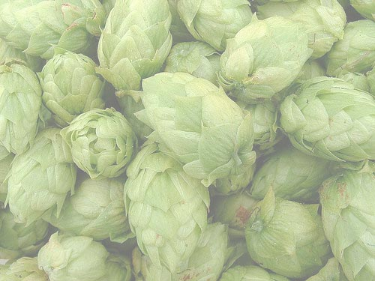
Organic solvent-free iso-α-acids are produced.
(Laws et al. of BRF 1979)
Directly separated α-acids, β-acids, and hop oils from CO₂ extract using pH partitioning.
(Miller Brewing Patent 1982)
Commercial tetrahydro iso-α-acids introduced in 1984
(Kalsec Patent 1975)
Tetrahydroiso-α-acids are produced from either α-acids or
β-acids using only hydrogen, air, ethanol, and water.
(Miller Brewing Patent 1985)
O
O
R
HO
O
OH
Tetrahydroiso-α-acids

Slide 19
Chemistry of Tetrahydroiso-α-acids
O
O
O
O
R
Mg⁺⁺/OH⁻
R
HO
O
OH
O
OH
H₂
OH
Pd/C
O
O
R
HO
α-Acids
Iso-α-acids
O
OH
O
O
OH
O
Tetrahydroiso-α-acids
R
H₂
R
O₂
Pd/C
HO
Mg⁺⁺/OH⁻
NaBH₄
O
OH
OH
Hexahydroiso-α-acids
Tetrahydrodesoxy
-α-acids
β-Acids
Hexahydro-β-acids

Slide 20
Comparison of Sensory vs.
Analytical Bitterness
15
14
Iso-α-acids
ρ-Iso-α-acids
13
Tetrahydroiso-α-acids
12
Sensory Bitterness Intensity
11
10
9
8
0
10
20
30
Analytical BU

Slide 21
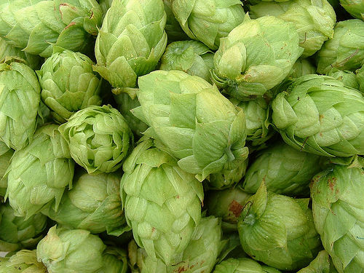
Tetrahydroiso
Hexahydroiso
Iso
ρ-Iso
Bitterness Intensity
Differences Between High and Low Isocohumulone (Shellhammer et al. 2004)

Slide 22
Under UV or visible light the tetrahydroiso-α-acids do not produce 3M2B1T which also leads to two newly discovered light struck flavors.
S-H
3M2B1T
O
O
R
=
HO
3M2B-methyldisulfide
OH
S-S-CH₃
O
S-S-SCH₃
3M2B-methyltrisulfide
Tetrahydroiso-α-acids
Tetrahydroiso-α-acids not only provide excellent light protection in beer, but also…
Notes:
Light from the sun, light bulbs or fluorescent light attacks hop bittering isoalpha acids and a source of beer sulphur such as amino acids.
The direct light attack is on the beer vitamin B2 (riboflavin). The activated riboflavin is the molecule that attacks and cleaves fragments from the isoalpha acid and the sulphur source.
The fragments are in a chemical form known as radicals, which are very reactive.
The two radicals combine to form the lightstruck compound 3-methyl-2-butene-1-thiol. This molecule has a flavor threshold of a few parts per trillion.
Miller scientists discovered that three related molecules actually form, each having the similar lightstruck / skunky / foxy aroma:

Slide 23
1970’s-2008
Foam
Improvement

Slide 24
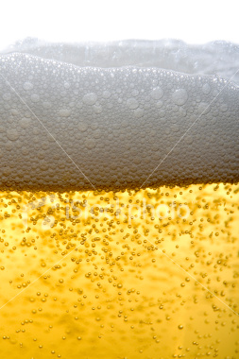
POWERFULLY ENHANCE FOAM STABILITY
Beer foam potential requires the interaction of hop bittering acids and beer proteins.
The more bitter the beer, the better the foam.
Tetrahydroiso-α-acids
  Preferentially interact with the most foam stabilizing compound in beer, LTP (barley lipid transfer protein), due to hydrophobic interactions.
  Retain foam potential because they do not degrade while Iso-α-acids degrade over beer shelf life.
  Protect the foam in non-pasteurized beer even while yeast proteinase A slowly destroys the foam proteins.

Slide 25
1970’s-2008
Anti-Microbial

Slide 26
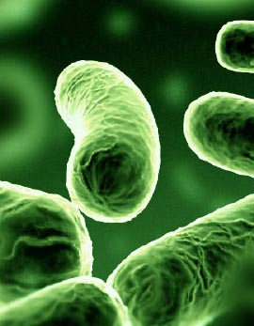
Hop acids have remarkable antibacterial properties against gram positive organisms. (Teuber 1970)
Hop acids act as ionophores transporting ions across the cell membranes of susceptible bacteria. This disrupts ion gradients across the membranes causing leakage, starvation and cell death.
(Teuber and Schmalreck 1973)
The greater hydrophobicity of the undissociated form of the hop acids enhances the ionophoric nature of the hop molecule resulting in increased antibacterial activity. (Simpson 1991-1993)
Tetrahydroiso-α-acids and Hexahydro-β-acids are the most antimicrobial of hops acids, but at two different pH values. (Miller Brewing 1987 and 1995)
Tetrahydroiso-α-acids show more effective anti-microbial action than iso-α-acids during the acid washing of yeast. (Miller Brewing 2001)

Slide 27
Effects of Hops on Disinfecting Brewer's Yeast Seeded with an Acid Resistant Pediococcus

Slide 28
Effects of Tetrahydroiso-α-acids on Disinfecting Brewer's Yeast Seeded with an Acid Resistant Pediococcus (at pH 2.3)

Slide 29
The Relative Anti-Microbial Activity of Hop Compounds
Hop Compound (optimal effective pH) | Relative Anti- Microbial Activity
Hexahydro-β-acids (pH 7)
Tetrahydroiso-α-acids (pH 4.2)
Iso-α-acids (pH 4.2)
ρ-Iso-α-acids (pH 4.2)

Slide 30
Fruit juices
(Alicyclobacillus)
Food Applications
(Listeria, Clostridium
botulinum or Bacillus spores)
Oral care products
(Streptococcus mutans)
Skin care products
(Propionobacterium acnes and Staphylococcus
aureus)
Feminine hygiene products, baby wipes, diapers
(Staphylococcal)

Slide 31
Bitterness
Foam
Biological Stability
Key
Takeaways
Hydrophobicity
Molecular Structures of iso α-acids derivatives

Slide 32
1950’s-2008
Flavor

Slide 33
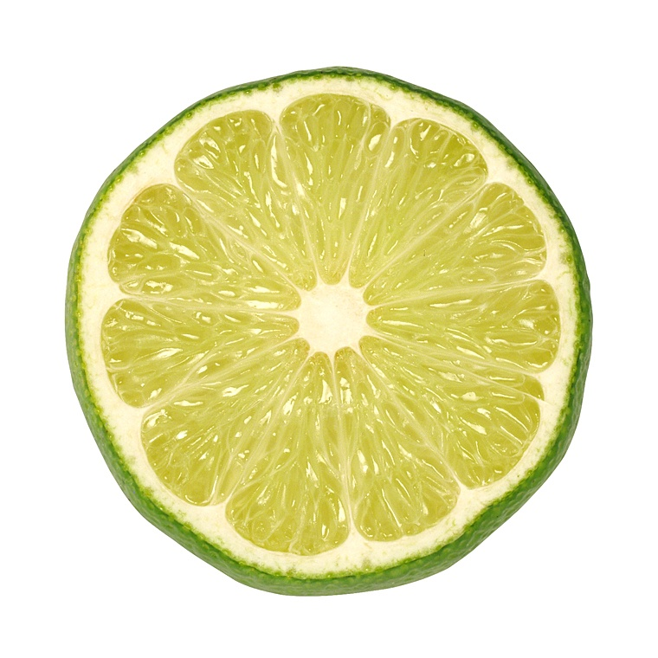
Hops also provide spicy, floral, citrus aroma and flavor, and “mouthfeel” characteristics to beer.
Early extensive investigations were conducted to
correlate the hop oil compounds to various hoppy
flavors in beer.
Flavor is not all about bitterness…

Slide 34
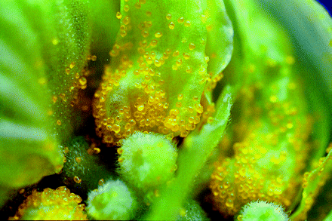
  Chapman’s early studies
  (1895-1929)
  Howard (BRF)
  Howard and Stevens (BRF)
  Irwin (Labatt)
  Fukuoka and Kowaka (Kirin)
  Peacock and Deinzer
  (Oregon State)
  Tressl (Technischen University, Berlin)
  Harley and Peppard (BRF)
  Lam, Foster II, and Deinzer (Oregon State)
  And many others………..
Hop Oils
> 300 Compounds
70% Hydrocarbons
30% Oxygenated Compounds

Slide 35
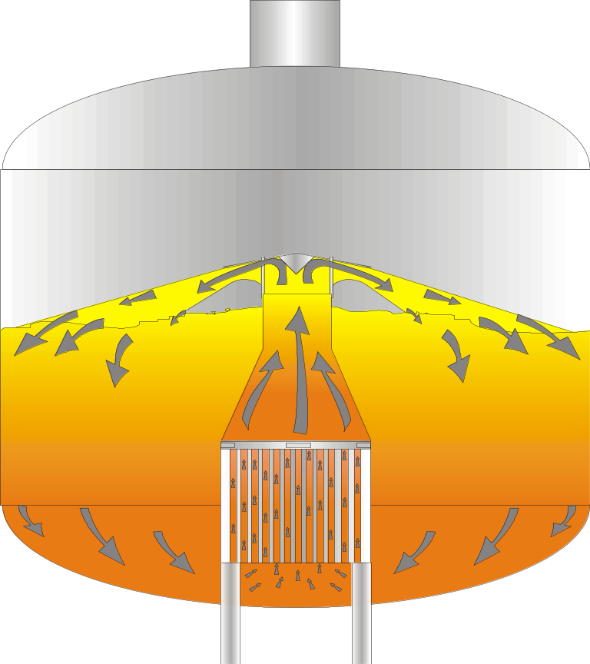

No single hop oil component has been shown unequivocally to be present in kettle-hopped beer.
  Buttery, Black, Lewis, and Ling
  Sandra and Verzele
  Peacock and Denzer
  Rigby
  Miller Brewing
The chemistry of hop flavor is still not properly understood.

Slide 36
Spicy fraction
Floral fraction
Citrus fraction
Fractionation of hop oils
(Haley, Peppard, Westwood et al. of BRF in 1985)
Commercial post-fermentation products became
available to mimic late and dry (resinous) hopping.
However, these fractions do not produce true early kettle hop flavor.

Slide 37
Glycosides: A Secret of Hop Flavor Revealed
In 1998, Miller Brewing found that the cellulose portion (hop solids) after CO₂ extraction contains a mixture of water soluble substances composed of 92.4 mole% of glucose with a majority of 55% terminal and other linkages.
Hops
Cellulose Portion
(Hop Solids)
CO₂ Extract
(Hop Soft-Resins)
Carbohydrate Residue | mole%
Glucose | 92.4
Rhamnose | 1.4
Ribose | 2.1
Xylose | 0.5
Mannose | 0.6
Galactose | 1.5
Arabinose | 1.5

Slide 38
Glycosides: A Secret of Hop Flavor Revealed
The terminal glucose made of a glucose molecule and an aromatic compound (aglycone) called β-glycosides.
A group of β-glycosides survive the kettle boil because they are water soluble and non-volatile.
Glucose
Terminal
6-linked
1,2-linked
2,6-linked
2,3,6-linked
%
55
22
10
10
3
HO
CH₂
HO
O
O
HO
HO
O
CH₂
OH
HO
O
OH
H
HO
HO
H
HO
O
Linalool
(Aglycone)
HO
CH₂
O
O
HO
H
HO
O
HO
HO
H
H
O
O
CH₂
HO
O
OH
Linalyl β-Glycoside
HO
O
O
CH₂
HO
O
OH
O
O

Slide 39

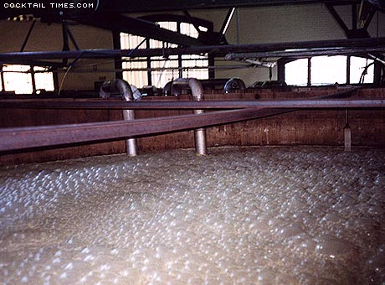
Glycosides: A Secret of Hop Flavor Revealed
Yeast can hydrolyze β-glycosides and further convert aglycones into hop flavor.
The β-glycosides present in the hop cellulose portion contribute the true kettle hop flavor in beer.
Further supported by
  H. Kollmannsberger and S. Nitz, 2002
  M. Biendl, H. Kollmannsberger and S. Nitz, 2003
  L. Daenen, D. Saison, L. De Cooman, G. Derdelinckx, H., Verachtert, F. R. Delvaux, 2006
H
OH
H
O
O
HO
HO
H
H
HO
H
Linalool (Aglycones)
+ Glucose
HOP FLAVOR COMPOUNDS

Slide 40
DIRECT ANALYSIS OF HOP β-GLYCOSIDES
Glycoside (MW) | Sugar | Aglycones (a=TFA; b=TMS; c=LC/MS)
236c | Glucose | 2-methyl propanol
250a,b | Glucose | 3-methyl-2-butanol, 3-methyl-1-butanol, 2-methyl-1-butanol
262a,b | Glucose | 3-hexen-1-ol
264c | Glucose | 1-hexanol, 3-methyl-2-pentanol, 4-methyl-2-pentanol
270a,b,c | Glucose | benzyl alcohol
284a,b,c | Glucose | 1-phenylethanol, 2-phenylethanol
290a | Glucose | 1-octen-3-ol
292a,b | Glucose | 1-octanol
314a | Glucose | ipsdienol
316a | Glucose | α-terpineol
316 | Glucose | linalool, geraniol, α-terpineol
318c | Glucose | citronellol
326c | Glucose | raspberry ketone
328c | Glucose | aceto vanillonol
332a,b,c | Glucose | 2,6-dimethyl-2,7-octadiene-1,6-diol
358c | Glucose | loliolide
368b,c | Glucose | 3-hydroxy-7,8-dihydro-β-ionone
386b | Glucose | grasshopper ketone
416a | Glucose-arabinose | phenylethanol
422a | Glucose-arabinose | 1-octen-3-ol
448a | Glucose-arabinose | α-terpineol
452a | Glucose-rhamnose | ipsdienol
462a | Glucose-rhamnose | linalool

Slide 41
1990’s-2008
Flavor
Stability

Slide 42
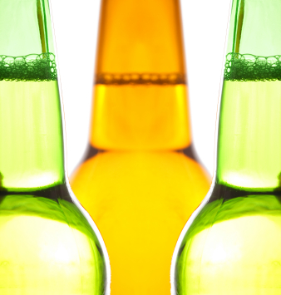
REACTIVE OXYGEN SPECIES
OR
FREE RADICALS
are detrimental to
beer flavor stability
or
shelf life..

Slide 43
Which hop compounds are antioxidants or antiradicals? That depends..
Humulone and lupulone by a DPPH
radical assay
(Motoyuki et al. 1995)
Polyphenols are negligible antioxidants in wort and beer by ESR
(Andersen et al. 1999)
Polyphenols by the rancimat method; Bittering substances by the fluoro-scan test (Forster et al. 2001)
Polyphenols by AAPH [2,2’-azobis(2-amino propane) dihydrochloride]
(Collin et al. 2001)

Slide 44
  Miller Brewing determined the antioxidant properties against the stable DPPH free radical.

Slide 45
  Some specific anti-oxidative polyphenols present
  in the hop cellulose portion:
    Catechin, dimer, trimer and tetramer
    β-Glycosides of kaempferol and quercetin
    Xanthohumol

Slide 46
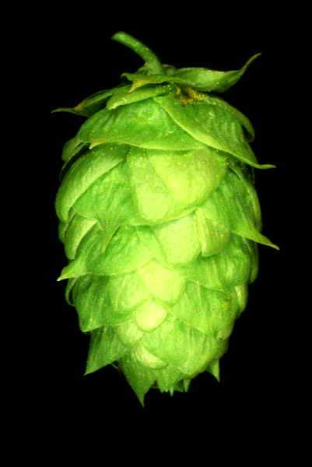
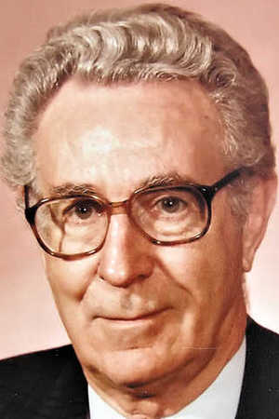
A pioneer in the hop industry
O
O
O
O
O
O
O
O
CH₃
H
OH
R
R
hv
CH₃
R
SH
H
HO
R
50 Years of Hop Chemistry
HO
O
R
3
O
HO
OH
OH
SH⁻
O
H
OH
HO
O
O
O
CH₃
OH
RO
O
O
B
H
OH
OH
H
A
C
H
O
R
1
O
H
O
Dedicated to Dr. Francis Lloyd Rigby
1918 - 2008

Slide 47
Acknowledgements
Lance Lusk
William Maca
Jason Pratt
Jay Refling
Linda Ting
Lance Lusk
William Maca
Jason Pratt
Jay Refling
Linda Ting

